Slide 1
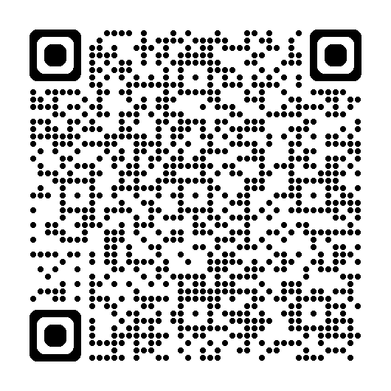
A Bright Future: Planning Ahead for After Graduation

Slide 2
Agenda for Today
Introductions and “The Why”
Disability Disclosure
Break
Resume Building
Resources and Q&A

Slide 3
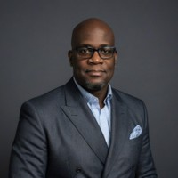
Introductions
Stanley Hughes
Jessica Stone
Devin Axtman

Slide 4
The Why
When you are seeking a job as a person with a disability, one of the first steps is creating your Resume/Cover Letter. You also then must think about if you want to disclose, when to do so, and how.
We want to help UNT students be prepared to have these conversations for employment while they are at UNT and after graduation.
Disclaimer on language use: We may use “student with a disability” and “disabled student “interchangeably throughout this presentation. We recognize that each individual has their own preference on how they identify and we respect that. To include the greater audience, we may use both.

Slide 5
Disability Disclosure
Notes:
Whether to disclose
Having a disability can be considered a liability in the job search due to the possible misconceptions or prejudices of the people you will encounter.
If you have a visible disability or need accommodations in the interview process, you may not have much choice.
When to disclose
If you have an invisible disability or a disability that is less obvious and does not require interview accommodations, you may not need to disclose until after you begin the job.
Probably more important than “when” you disclose your disability is “how” you do it. They way that you present your disability can greatly affect how the employer will view it.
Needed accommodations
If you do require a reasonable accommodation on the job, you still do not need to disclose your need for accommodations until after you have been offered a job.
If accommodations during the interview process will help you show up as your best, most confident self, it is okay to request those accommodations.

Slide 6
YOU determine what to disclose, and when.
Notes:
There are no hard rules when it comes to disclosing a disability. It will ultimately be up to you make decision.

Slide 7
No Single Right or Wrong Approach
Disability disclosure can occur during any stage of the employment process
Including: Pre-employment, Post-offer, and while employed
It can be within days, months, or years of being hired
Employers are not permitted to ask non-voluntary disability-related questions on a job application

Slide 8
What to Consider Before Disclosing
Whether you want to disclose at all
If you're open to disclosing, when you should disclose
Whether (and when) you'll need accommodations
How you’re going to disclose
Notes:
Whether to disclose
Having a disability can be considered a liability in the job search due to the possible misconceptions or prejudices of the people you will encounter.
If you have a visible disability or need accommodations in the interview process, you may not have much choice.
When to disclose
If you have an invisible disability or a disability that is less obvious and does not require interview accommodations, you may not need to disclose until after you begin the job.
Probably more important than “when” you disclose your disability is “how” you do it. They way that you present your disability can greatly affect how the employer will view it.
Needed accommodations
If you do require a reasonable accommodation on the job, you still do not need to disclose your need for accommodations until after you have been offered a job.
If accommodations during the interview process will help you show up as your best, most confident self, it is okay to request those accommodations.

Slide 9
Disclosing in the Interview Process
Determine whether you feel comfortable disclosing during the interview process
If you do require a reasonable accommodation on the job, you do not need to disclose this until after you have been offered a job
Disclosing to ask for interview accommodations may help you show up as your best, most confident self
For example, if you're neurodivergent and perform better with preparation, you can ask to see the interview questions ahead of time. If you have sensory processing issues, you can ask for the interview to be conducted in a quiet room without ambient noise
If you need to bring an interpreter or another assistive device to the interview, let the interviewer know so they can prepare

Slide 10
Requesting Interview Accommodations
Have a standard script you use when requesting interview accommodations
Take the opportunity to educate, as not every employer will have experience navigating accommodations
Example: "I am really pleased to have the opportunity to interview for this job. However, I am deaf, and to interview effectively, I will need communication access provided by a Sign Language Interpreter. If you are not familiar with this service, I can help you make these arrangements or you can call an interpreter service directly at..."

Slide 11
Answering Questions in the Interview
Be proactive in educating and easing tension
An interviewer can ask questions about your ability to perform job functions and require you to describe how you would perform those functions. They cannot ask specifically about your disability, though.
Show you're prepared to handle the job requirements and reframe them in a practical way
Example: Mention that as long as your phone can be connected to your hearing aid via Bluetooth, you'll have no problem answering calls.

Slide 12
Discussing Disability-Related Work Gaps
If you took time off work to address a disability or medical condition, you do not have to disclose this information to a potential employer
The employer can still ask about employment gaps, so prepare your answer in advance by writing out a script
"I took time away from an office environment to address a medical condition that's now been taken care of, and I'm ready to get back to work."
"I left my last position to manage a health issue which is now under control, and I'm eager to get back to working full-time."

Slide 13
Disability Disclosure Post-Offer
Employers may encourage individuals to share disability-related information during the post-offer stage of employment as they may ask medical questions or require medical examinations before a newly hired employee begins working.
Employers just have to ask the same questions to every applicant in this stage who are offered the same type of job.
Timing of a request can be rather important. It is better to disclose a disability and request accommodations before job performance is negatively impacted.

Slide 14
Disability Disclosure Post-Offer
Sometimes employees disclose disability-related information but don’t specifically request an accommodation. This can make it difficult for supervisors to know what is needed based on that disclosure.
If you are disclosing your disability with the purpose of requesting an accommodation, it is important to make this disclosure to the right person – the person who can act upon the request, such as the supervisor or HR Professional.
You don’t have to worry about using specific language, including that you need accommodations under the ADA. You can just use plain language to make this request and employers must act upon it.

Slide 15
Remember, lead with confidence!

Slide 16
Stan Hughes, MBA MSOB
Career Coach
College of Liberal Arts &
Social Science
Building Your Professional Resume

Slide 17
Today we will cover...
The Purpose of a Resume
Introduction to Applicant Tracking Systems Resume Building (Section by Section) General Resume Do's & Don'ts
Additional Resources

Slide 18
Purpose of a Resume
A Resume should be used to:
To showcase your most relevant qualifications for a specific job
Convince the employer that you are qualified for the role they are looking to fill Get your foot in the door for an interview
A Resume should not be:
A comprehensive overview of your outdated/irrelevant work history
A copy and pasted list of your previous job descriptions
A one size fits all document that is used for every position you apply for

Slide 20
Applicant Tracking Systems (ATS)
Computer systems used by recruiters and hiring professionals that scan resumes for specific qualifications and keywords based on the job description you are applying to
99% of Fortune 500 companies use Applicant Tracking Systems to screen candidates
Formatting and Content matter!
Do not use preformatted templates from the web- keep it simple and use a word document or template provided by Career Services
Avoid complex formatting like images, icons, graphics, tables, and columns Use simple and consistent text formatting throughout
Tailor your resume content (summary, skills and experience) to the qualifications of the job
Meet with a Career Coach to make sure your resume aligns with the job description you are applying for before submitting it!

Slide 21
Sections of a Resume
1
Header
2
Summary
3
Education
4
Experience
5
Additional Sections
Campus Involvement Honors & Awards Volunteer Experience Research Experience

Slide 22
Header Section
Name, Contact Information and Location
Name should appear at the top of the page in a large font. Include first and last name as well as your preferred name if applicable
Phone number should include dashes or dots to break numbers up and make it easier to read (123-456-7890 or 123.456.7890)
Use a professional and active email address
Include the city and state of your location, avoid listing your physical street address to avoid security risks and potential hiring biases
You can also use this section to list your LinkedIn URL or professional online portfolios/websites
When listing your LinkedIn URL, make sure your LinkedIn is up to date, active and positively represents your experience and skills. You can personalize your LinkedIn URL using these instructions

Slide 23
Header Examples
First Last
Denton, TX | 123-456-7890 | student@my.unt.edu
First “Preferred” Last
Denton, TX | 123-456-7890 | student@my.unt.edu | www.linkedin.com/in/untstudent
First Last
Denton, TX 123-456-7890
student@my.unt.edu www.linkedin.com/in/untstudent
Avoid stacking information to conserve real estate and eliminate the look of excess blank space

Slide 24
Summary
A resume summary is optional, but recommended. It can add value to a resume when done properly.
It should contain keywords from the job description and summarize your most relevant and transferable skills/experiences.
A summary can be anywhere from 3 – 5 sentences Avoid generalizations and cliches here
Avoid the use of I, my and me throughout to keep the language formalized A good starter formula for a summary might include:
Who You Are
Your Relevant Skills/Experiences
What You Are Seeking & Why

Slide 25
Summary Example
SUMMARY
Current Junior at the University of North Texas pursuing a Bachelor of Science in Psychology. Skilled communicator and active listener with experience building intentional relationships with others and working collaboratively with team members on projects and through student organizations. Seeking an internship with a non-profit organization that will enhance administrative skills and provide exposure to serving underrepresented populations in the Dallas community.
SKILLS: Fluent in English and Spanish | Data Entry | Data Analysis | Proficient in Microsoft Excel and Word | Research | Assessment | Team Leadership | Critical Thinking | Customer Service | Processing Classified Information | Cash Handling | Budget Management
In addition to a summary, you may also use this section to list relevant skills and keywords that align with what the employer is looking for. These can be language skills, technical skills, industry knowledge or industry-specific competencies

Slide 26
Education
If you are a current student or recent graduate, your education should be listed toward the top of the resume.
If you are a freshman, you can list high school. If you are a sophomore+, remove high school Do not include incomplete degrees or transfer institutions in this section
Education should be listed in reverse chronological order (current/most recent at top) and contain the following:
Full and proper name of completed degree(s)- Avoid abbreviations Name and location of institution
City and State of institution Graduation month and year
You can also use this section to list any minors, concentrations and/or academic honors such as Dean’s List, President’s List, Honors Student, Suma Cum Laude, GPA, etc.

Slide 27
Education Example
EDUCATION
Bachelor of Science, Psychology
Minor, Sociology
University of North Texas- Denton, TX
Dean’s List: Fall 2022 | Spring 2023
May 2025
4.0 GPA
Associate of Applied Science, Business Administration
Concentration, Management
Tarrant County College- Fort Worth, TX
Aug. 2021
3.75 GPA

Slide 28
Experience
Use this section to list your past work experiences in reverse chronological order
If you do not have work experience, consider using this section to elaborate on your leadership roles in organizations or volunteer experiences
Each experience listed should include the following: Position
Name of Company
City and State of Company
Months and years worked (Sept. 2020 – Present)
Skill-oriented bullet points that describe what you did and what skills you employed while doing it
You can also use these bullet points to talk about promotions, achievements, or other notable contributions to the job Avoid just listing your duties- these aren’t as transferable as the skills you employed are.
Use this section to list only your most relevant and recent experience. Remember, this should not serve as a comprehensive work history!
Avoid listing experiences older than 10+ years

Slide 29
Experience Example
EXPERIENCE
Orientation Leader Apr. 2022 - Present
University of North Texas – Denton, TX
Served as a resource for roughly 300 first-year college students by facilitating various small group meetings discussing campus services, university policies and answering questions
Worked collaboratively with a team of 30+ Orientation Leaders and served as a team lead for 3 large programs and 6 Orientation sessions
Recognized by peers and leadership for taking initiative to assist with Family Orientation during staffing shortages Demonstrated professional communication skills when interacting with students, families, staff and faculty during Orientation sessions.
Barista/Team Lead Sep. 2021 – Apr. 2022
Starbucks- Highland Village, TX
Utilized exceptional customer service skills and built intentional relationships with customers by greeting and taking orders in a welcoming and friendly manner
Processed orders quickly and efficiently while maintaining professionalism and ensuring orders were fulfilled with accuracy
Responsibly handled cash and card transactions, adhering to cash handling policies
Promoted to Team Lead for dependability, professionalism and ability to problem solve effectively

Slide 30
Additional Sections
Involvement: Use this section to list campus involvement.
Be sure to include your level of involvement (Member, President, Participant, etc.), the name of the organization and the months/years you were involved in reverse chronological order.
Honors & Awards: If you have other Awards/Honors from college that are not already mentioned on your resume, you can list them here.
Be sure to include your title (Recipient, Honoree, Nominee, etc.), the name of the award and when it was obtained in reverse chronological order.
Volunteer: If you have volunteer experience that adds value to your resume, you can list it under this section.
List your title (Volunteer, Sunday School Teacher, Student Volunteer, etc.), the name of the organization and the number of hours or months/years of involvement in reverse chronological order.
Research/Projects: If you have research projects or other group projects that are relevant to your industry, you can list them in this section.
Include your level of involvement (Project Lead, Team Member, Research Assistant, etc.), the name of the project, the month(s)/Year(s) and a bullet point or two that detail what the project was over, what your role was and what the purpose/outcome was.

Slide 31
Additional Sections
INVOLVEMENT
President, Alpha Phi Omicron
Member, Student Government Association
Member, Baptist Student Ministry
Fall 2023 - Present Spring 2022 - Present Spring 2022 - Present
HONORS & AWARDS
Nominee, University of North Texas Homecoming Royalty
Recipient, 2022 Outstanding Orientation Leader
Fall 2023
Summer 2022
VOLUNTEER EXPERIENCE
Volunteer, Denton County Friends of the Family
Participant, Big Event Service Project
Spring 2022 – Present Spring 2022
RESEARCH EXPERIENCE
Project Team Member, Sport Psychology
Worked collaboratively with a group of 4 other students to conduct research on the effects of social media on professional athletic performance
Creatively and professionally documented findings using Canva and presented collected research to an audience of 30+ students and 2 faculty members.

Slide 32
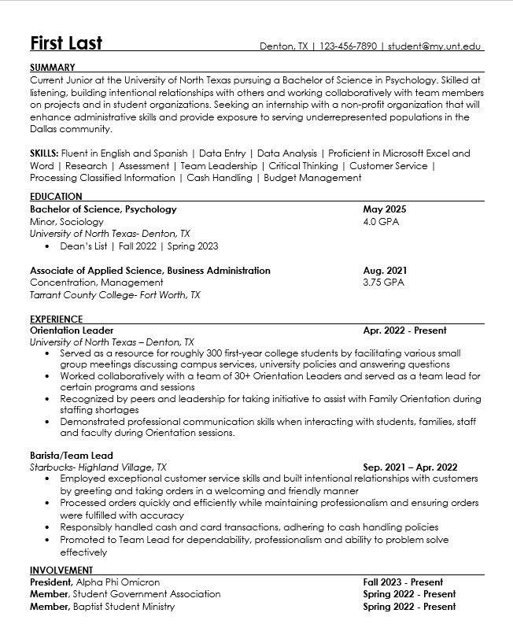
Chronological Resume Example

Slide 33
Resumes Do's
Always make sure you proofread your resume for spelling, grammar and punctuation errors
Tailor the content of your resume to the position you are applying for. Using a job description when building a resume is like having a study guide for an exam!
Keep your resume to 1 page. 2 pages are okay if you have lots of relevant experience.
If you are tight on space, you can reduce your margins to 0.5 in. on all sides as opposed to 1 in.
You can also conserve space by using line dividers ( | ) as opposed to bullet points to list information horizontally instead of vertically.
Use an appropriate font style and size (10.5 – 12 pt. font). For example:
Times New Roman
Arial
Calibri
Use consistent text formatting to draw the eye to key details (bolding, italics and underlining).
Use consistent date formatting throughout (10/2022 vs. October 2022 vs. Oct. 2022) Use consistent state formatting throughout (TX vs. Texas)
Align dates so they balance the page and make the resume easier to read

Slide 34
Resumes Don'ts
Do not use pre-formatted template from online. instead, create one from scratch or use one of the templates provided by the Career Center
Don't use a general resume for every job you apply for. Remember, resumes should not be one size fits all! Avoid acronyms (UNT, MBA, BS, etc.)
Avoid color, graphics, images, etc.
Do not use insert columns on your resume Do not use I, me, my, their, we, etc.
Do not use creative or unfamiliar section headers (“Where I’ve Been”, “What I’ve Done”, “Why You Should Hire Me”) Do not list references on your resume or state “Reference Available Upon Request”
Reference Page Example

Slide 35
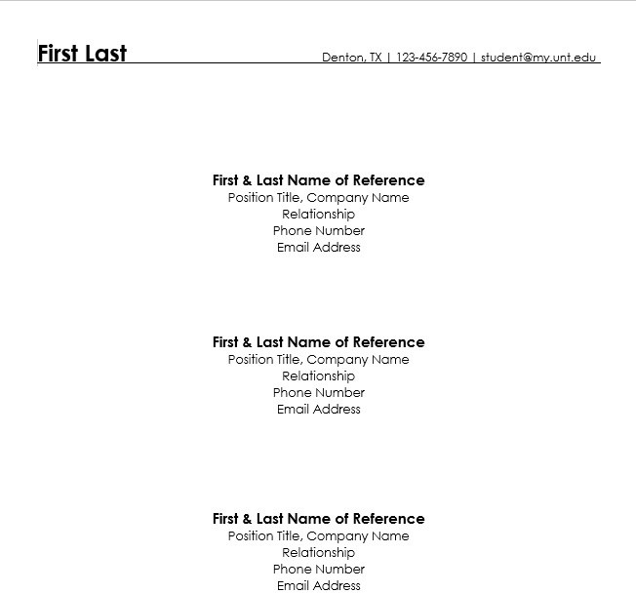
Reference Page Example

Slide 37
Additional UNT Resources
Career Center Website
LinkedIn Learning
Meet with a Career Coach!

Slide 38
Disability-Specific Job Search Resources
Attend virtual career fairs
Career Center events
Ask for accommodations (in-person or virtual events)
Consider remote jobs or flexible work environments
16% of companies worldwide are fully remote
Apply to work for employers with a history of accessibility
Use resources like the Disability:IN of "Best Places to Work"
Search for companies with disability recruitment programs like the U.S. government's Workforce Recruitment Program
Find companies with disability-related Employee Resource Groups
Texas Workforce – Vocational Rehabilitation Services – Provides employment supports for people with disabilities

Slide 39
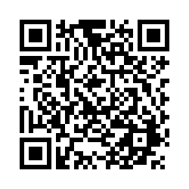
Thank you for attending!
Stan Hughes: Phone: 940-565-2105 GAB, Room 111 Stanley.Hughes@unt.edu
Jessica Stone: Phone: 940-565-4323 Chestnut Hall, Suite 102 Jessica.Stone@unt.edu Devin Axtman: Phone: 940-565-4323 Chestnut Hall, Suite 102 Devin.Axtman@unt.edu

