Slide 1
ODA Annual Town Hall Fall 2024
Hosted by: The Office of Disability Access

Slide 2
Welcome
Welcome!
Introductions of ODA Town Hall Hosts
Jessica Stone, Director
Randi Johnson, Associate Director
Steven Harris, Assistant Director
Devin Axtman, Assistant Director

Slide 3
Agenda
Welcome and Introductions
Guidelines for Event
Objectives for Town Hall
Exciting news – New Space!
Overview of ODA
Expanded Services
Key Metrics
Tools Available on ODA Website
Power of Partnership
Accommodations
Accessibility of Student Programming
Accessible Workplace
Conclusion & Contact Information

Slide 4
Town Hall Guidelines
Devin Axtman will moderate the chat and will answer questions in the chat throughout the Town Hall
All questions/answers will be posted on the Town Hall website after for accessibility reasons and any significant questions that need to be addressed during the Town Hall, Devin will announce.
Specific questions on a particular application of accommodation – please contact us to discuss
Access Information:
ASL Interpreter and CART Provider provided
Recording will be available on ODA Website under Trainings
PowerPoint is already available on ODA Website under Trainings

Slide 5
Objectives
Share relevant updates from the Office of Disability Access
Update and remind the campus community of supports and services offered by the Office of Disability Access
Continue to encourage dialogue on how to support students with disabilities both academically and non-academically
Listen to feedback of tools faculty and staff would like us to provide to assist with accommodating students and making their content accessible
Transition to Steven

Slide 6
The Office of Disability Access

Slide 7
Exciting News – New Space!
ODA Office Suite – Chestnut Hall, Room 102
ODA Testing Center – Chestnut Hall, Room 115
ODA Conference Room – Chestnut Hall, Room 160
We’d love to show you our new space! Please call (940-565-4323) or email (disability@unt.edu). ☺

Slide 8
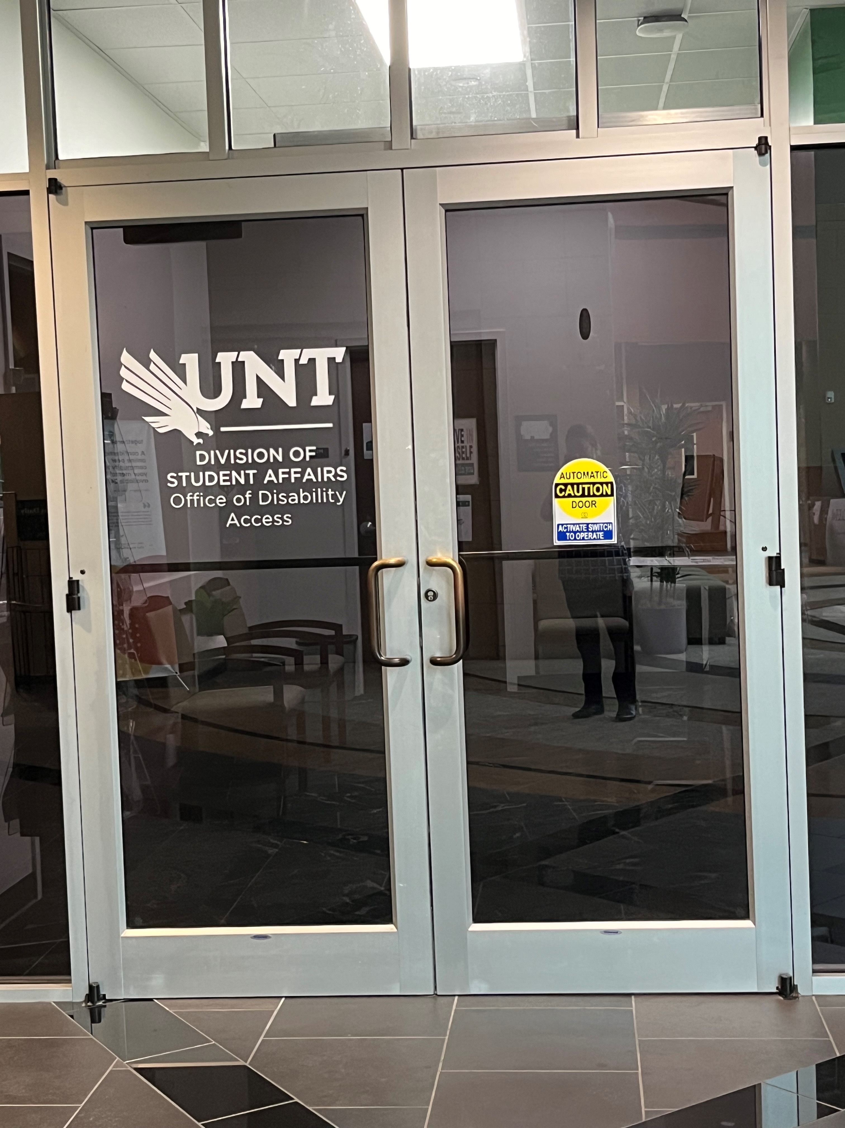
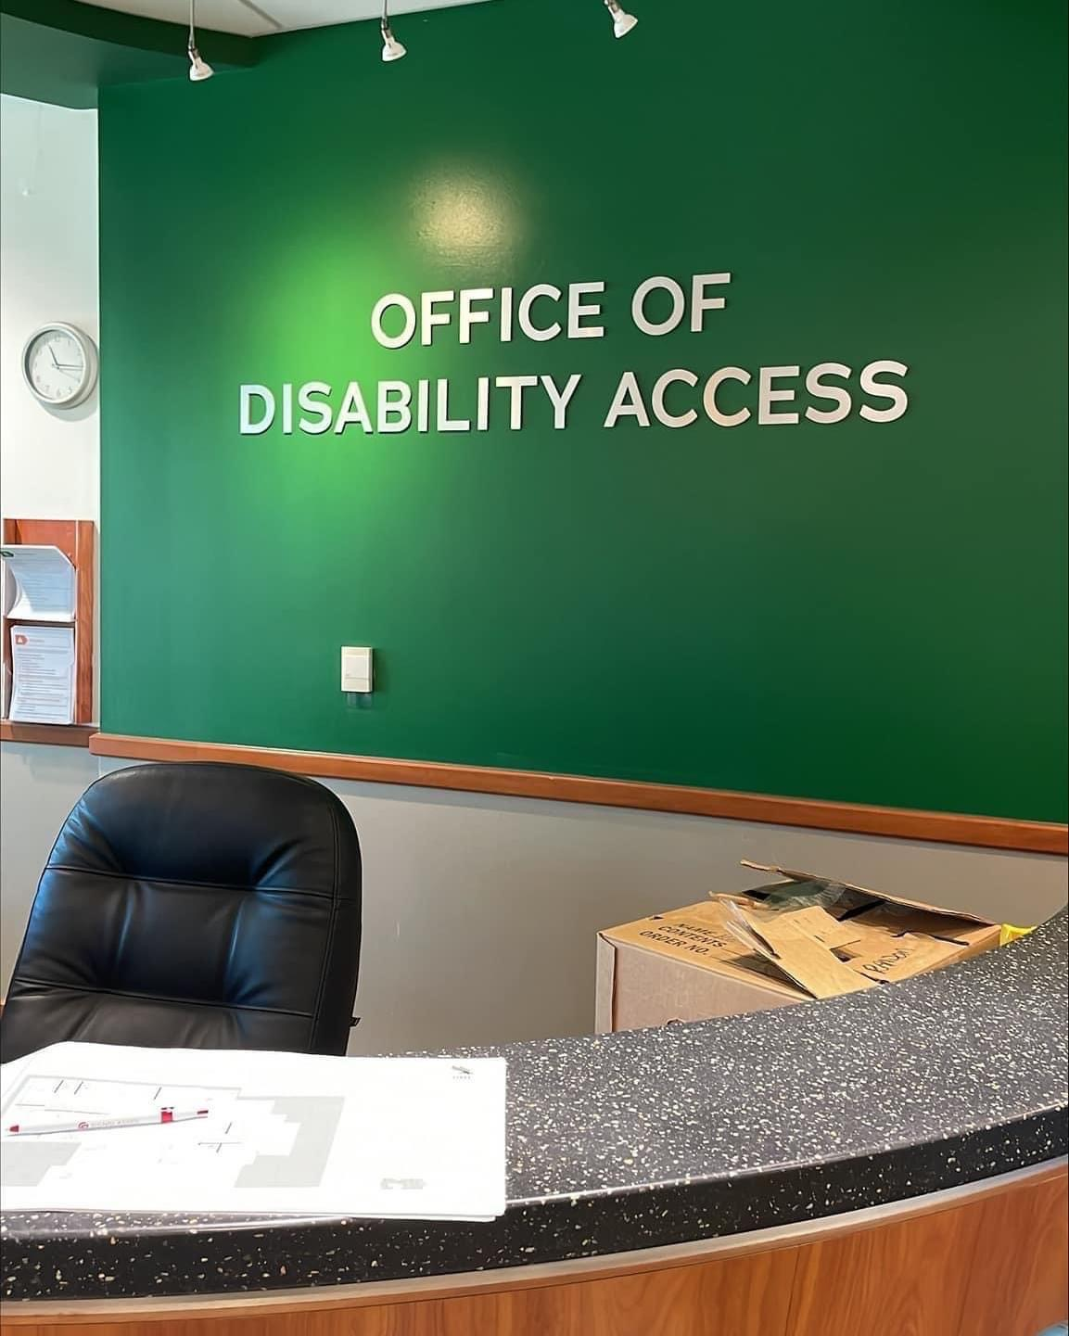
Exciting news – New Space

Slide 9
Division
Division of Student Affairs – Dr. Elizabeth With
AVP Health and Wellness – AVP Laurie Klein

Slide 10
Our Mission and Purpose
It is the mission of the Office of Disability Access to engage and collaborate with faculty and other campus partners to ensure students with disabilities at the University of North Texas have access to all university programs, services, and activities; promote equity and inclusion for students with disabilities; and provide a platform for accessible pedagogical innovation.
The Office of Disability Access envisions a campus community that values disability as an aspect of diversity where inclusive practices ensure a campus that is accessible to all and free of educational, institutional, technological, and attitudinal barriers.

Slide 11
WHAT WE DO (OUR ROLE)
The Office of Disability Access (ODA) serves as the central campus resource for the University community related to students with disabilities and accommodations to remove barriers to access.
The ODA collaborates with and empowers students in coordinating accommodation and accessibility needs with the goal of gaining equal access to education and university life
We also exist to prevent discrimination based on disability and to help students reach a higher level of independence.

Slide 12
WHAT WE DO (OUR ROLE)
We achieve this mostly by assessing and determining reasonable academic accommodations.
We work with faculty to provide assistance with how to implement approved accommodations, if needed.
We work with students to self-advocate their needs and provide guidance on how to communicate their academic accommodation needs to faculty.
We also provide trainings and educational opportunities to faculty and staff about access

Slide 13
OUR STAFF
Our caring and professional staff helps students learn more about their disabilities, provide accommodations coordination, and develop techniques to facilitate individual learning styles.
Our students are assigned specific Coordinators by name and specialized groups (i.e. ASD, BVI, DHOH, etc.); however, each of our staff is knowledgeable and capable of helping every student.

Slide 14
OUR STAFF
Jessica Stone - Director
Randi Johnson – Associate Director
Pamela Jackson – Assistant Director
Devin Axtman – Assistant Director
Steven Harris – Assistant Director
Keeley Glogau – Digital Accessibility Specialist
Kevan Johnson – Student Coordinator
LaShaundria Lawson – Student Coordinator
Courtney Gibson – Student Coordinator
Natalie Vinzant – Student Coordinator
Katy Sutton – Student Coordinator
Mona Isola – Testing Center Specialist
Febe Moss – Administrative Coordinator
Kayli Floyd – Sign Language Interpreter
VACANT – New Sign Language Interpreter
Graduate Assistants
Student Employees

Slide 15
Service Areas
As discussed, our primary focus is providing academic accommodations for equal access.
We do this by not only approving/arranging accommodations while students are in class (preferential seating, extra time on assignments, recording lectures, etc.), but also through other specialized services such as our Alternative Formats lab (Conversion Lab), Communication Access Services, Assistive Technology Loan Program, Notetaking Services, and Accommodated Testing.
This ensures that we are providing access in each area that students may need.

Slide 16
Service Areas
Alternative Formats Lab Highlights:
If a student is approved for alternative formats for textbooks and required course materials, our Alternative Formats lab will convert the materials for the faculty. We have a great group of trained students who do this!
The main service area we will highlight today is Accommodated Testing Services.
In addition to the Testing Center, our Accommodated Testing team provides ongoing training and technical assistance on how to provide accommodations in the classroom environment and on Canvas.

Slide 17
ODA TESTING CENTER
Responsible for ensuring that ODA-registered students receive approved testing accommodations, being proctored by the ODA Testing Center
Process student’s tests requests in AIM for approval/denial
Schedule exams in the ODA Testing Center
Adhere to our procedures and protocols to protect academic integrity
Securely store exams until exam date and for instructor pick-up
Return exams to instructors according to instructions (academic department, scan and email)

Slide 18
ODA TESTING CENTER
Once a student is approved for alternative testing accommodations:
Approved accommodations are listed on LOAs and sent to instructors
Approved accommodations can include extra time on exams/quizzes and distraction-reduced testing environment (most common)
At this time, student is eligible to start receiving those accommodations:
Instructors become responsible for providing the accommodations on their own, or have the option to utilize the ODA Test Center
In order to use the ODA Test Center, instructors MUST complete an Alternative Testing Agreement (ATA) form

Slide 19
ODA TESTING CENTER
The Alternative Testing Agreement form lets the ODA Test Center know the parameters of your exams
Specified times, dates, materials allowed/not allowed, etc.
This also lets us know if students are allowed to test on alternative dates or at alternative times
Completing this form is the first step in having a student test at the ODA Test Center
We ask that instructors complete this step as soon as possible (preferably when you receive the Letter of Accommodation) as to not delay the process
Students also will not be able to submit any exam request to schedule their exams in the ODA without the ATA being completed

Slide 20
ODA TESTING CENTER
Exams must be scheduled within the date and time parameters outlined by the instructor according to the agreement form
Exams scheduled outside of these parameters will be denied until approval is received from instructor
Exams can be denied if they are not scheduled by the deadlines the ODA has in place. This is due to the time it takes to arrange for a test administration, especially if assistive technology or other specialized accommodations are involved.
Students cannot be denied testing accommodations once they request them, unless it is a fundamental alteration of the course. If the instructor believes it is a fundamental alteration, UNT policy dictates that the Faculty member must communicate with the ODA Coordinator before denying the accommodation
Transition to Randi

Slide 21
Expanded Services

Slide 22
Staff ASL Interpreters
UNT has an amazing population of d/Deaf and Hard of Hearing students, necessitating the need for staff interpreters
We now have a full-time ASL interpreter, Kayli Floyd, who is available to provide more last-minute interpreting coverage.
Highly qualified ASL interpreter
Currently hiring for another ASL Interpreter, who will be a 9-month interpreter
Still utilize contracted agencies as needed

Slide 23
Digital Accessibility Support
ODA Digital Accessibility Specialist: Keeley Glogau
Works closely with DSI-CLEAR’s Compliance/Digital Accessibility team
Primarily focused on face-to-face classes with digital content
Increasing supports for student programming and non-academic consultations

Slide 24
Braille on-site support
Braille has a significant lead time due to needing certified transcriptionists for more advanced braille transcription, such as STEM subjects and Music
However, we have increased production and use of our on-site braille printer in Chestnut Hall, Room 115.
Available for blind student use to print their notes, etc.
Departments need it for accessible materials for non-academic, please contact our Alternative Format team to arrange (Books.ODA@unt.edu)

Slide 25
Key Metrics
2023-2024 metrics as of mid-July:
New Student Applications: 1331
Enrolled Students Registered with ODA: 2849
Number of Letters of Accommodation Sent: 18154
Unique Number of Students who Interacted with ODA: over 3616
Number of Coordinator appointments: Nearly 2000
Number of Classes with a CART Provider or ASL Interpreter: 305
Number of Tests Administered in Testing Center: 5766
Number of Hours of Exams Proctored: 5603
Transition to Jessica

Slide 26
ODA Website

Slide 27
Resources on ODA Website for Faculty/Staff

Slide 28
Resources for Faculty

Slide 29
Resources for Faculty

Slide 30
Resources for Faculty

Slide 31
Resources for Faculty AND Staff

Slide 32
Resources for Faculty AND Staff

Slide 33
Resources for Faculty AND Staff

Slide 34
Resources for Faculty AND Staff

Slide 35
Resources for Faculty AND Staff
Transition to Randi

Slide 36
Power of Partnership

Slide 37
Power of Partnership
We truly are here to PARTNER with faculty and staff in working with students
Invite opportunities to learn more about what’s working and what’s not – open invitation for conversation
We work with campus partners such as Facilities, Dean of Students, Counseling and Testing, and more to engage in conversations about how to be more accessible.

Slide 38
Campus Partners – A for Accessibility!
Union Programming and Arts – Molly Orr
Captions on all movies
Center for Belonging and Engagement – Kathleen Hobson
Accessibility is always at the forefront of their planning
Housing – Brad Dye
Housing Accommodations
Orientation – Brittany Landau
Excellent customer service, facilitation, and communication for accommodations at Orientation
The Rec Center
Visually Impaired access to equipment
Dining
Dietary Accommodations

Slide 39
Accommodations

Slide 40
New Projects
To better accommodate students and support faculty in providing accommodations, we are collaborating with campus partners on many projects, including the following:
Establishing better collaborations and supports for Student Teachers and at other clinical sites
Working on solidifying the Fundamental Alternations process with the Provost’s Office
More on-demand training options available based on faculty/staff feedback

Slide 41
New Accommodations
Not a cookie-cutter list of accommodations
Charged to review accommodations on an individualized basis based on student barriers and therefore sometimes we may need to create a new accommodation
Clinical Site Accommodations:
Site Interview
Site Placement
Scheduling considerations for Site
Modification of Attendance at Site

Slide 42
Accommodation Clarification
Added additional language on the letter of accommodation and provided more guidance on ODA website for many accommodations including:
Advance Class Materials
Modification of Course Attendance Policy
Occasional Extension of Due Dates

Slide 43
Student Access Outside the Classroom
Began more programming and outreach regarding student access outside the classroom
We know that student engagement is a significant part of student success.
Campus community is charged with ensuring that all of the wonderful engagement options are accessible for all.
Common accommodations ODA supports for student programming:
Communication Access – ASL interpreters/CART providers
Alternative Formats for Students with Print Disabilities – depending on timeline of request (priority is academic materials)
Consultation on how to provide accommodations and make programs accessible

Slide 44
Accessible Workplace
ODA is always willing to provide consultations to departments on how to make their department a more accessible place to work for people with disabilities.
However, we do NOT handle any accommodations for staff, including student staff.
Individuals interested in obtaining workplace accommodations should contact Keeshala Henderson, Workplace Accommodations Administrator for UNT System
Americans with Disabilities Act (ADA) (untsystem.edu)

Slide 45
Thank you and Survey
Thank you so much for joining us!
We will email out a copy of the presentation materials as well as a brief survey.

Slide 46
Contact Information
Emails:
Main email: disability@unt.edu
Jessica Stone: Jessica.Stone@unt.edu
Randi Johnson: Randalynn.Johnson@unt.edu
Steven Harris: Steven.Harris@unt.edu
Devin Axtman: Devin.Axtman@unt.edu
Phone:
Teams
940-565-4323

