Slide 1
ODA Annual Town Hall Fall 2025
Hosted by: The Office of Disability Access

Slide 2
Welcome
Welcome!
Introductions of ODA Town Hall Hosts
Jessica Stone, Director
Randi Johnson, Associate Director
Steven Harris, Assistant Director of Accommodated Testing
Devin Axtman, Assistant Director of Accessible Instruction and Assistive Technology
LaShaundria Lawson, Assistant Director of Student Access
Febe Moss, Administrative Coordinator
Notes:
Jessica

Slide 3
Agenda
Welcome and Introductions
Guidelines for Event
Objectives for Town Hall
Reminder of Location
Overview of ODA
Expanded Services
Key Metrics
Tools Available on ODA Website
Recognition of Partnership
Accommodations
Accessibility of Student Programming
Accessible Workplace
Conclusion & Contact Information
Notes:
Febe

Slide 4
Town Hall Guidelines
Our team will moderate the chat and will answer questions in the chat throughout the Town Hall, as we are able.
All questions/answers will be posted on the Town Hall website after for accessibility reasons and any significant questions that need to be addressed during the Town Hall, Devin or Steven will announce.
Specific questions on a particular application of accommodation – please contact us to discuss
Access Information:
ASL Interpreter and CART Provider provided
Recording will be available on ODA Website under Trainings
PowerPoint is already available on ODA Website under Trainings
Notes:
Devin

Slide 5
Objectives
Share relevant updates from the Office of Disability Access
Update and remind the campus community of supports and services offered by the Office of Disability Access
Continue to encourage dialogue on how to support students with disabilities both academically and non-academically
Obtain feedback from faculty and staff regarding tools they would like us to provide to assist with accommodating students and making their content accessible
Notes:
Devin

Slide 6
The Office of Disability Access
Notes:
Randi

Slide 7
New-ish Space!
Moved into our location in January 2024!
ODA Office Suite – Chestnut Hall, Room 102
ODA Testing Center – Chestnut Hall, Room 115
ODA Conference Room – Chestnut Hall, Room 160
We’d love to show you our space! Please call (940-565-4323) or email (disability@unt.edu). ☺
Notes:
Randi

Slide 8
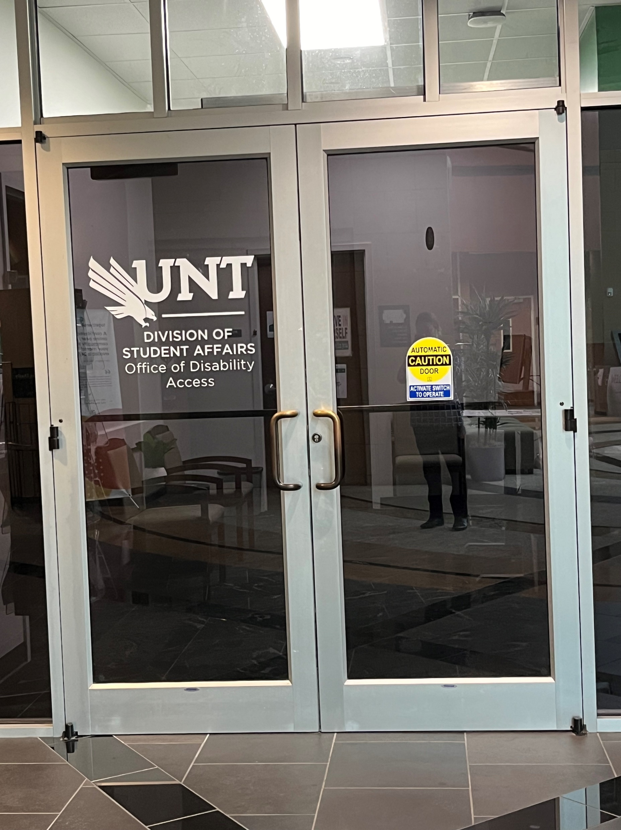
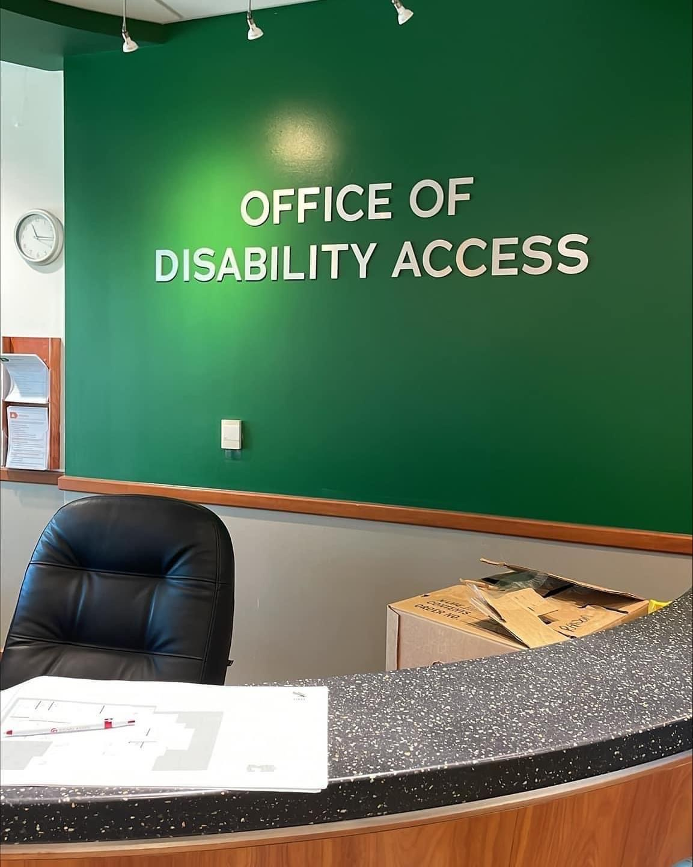
Our Locations
Notes:
Randi

Slide 9
Division
Division of Student Affairs: Senior Vice President Dr. Elizabeth With
AVP Health and Wellness: Assistant Vice President Laurie Klein
Notes:
Randi

Slide 10
Our Mission and Purpose
It is the mission of the Office of Disability Access to engage and collaborate with faculty and other campus partners to ensure students with disabilities at the University of North Texas have access to all university programs, services, and activities; promote equity and inclusion for students with disabilities; and provide a platform for accessible pedagogical innovation.
The Office of Disability Access envisions a campus community that values disability as an aspect of diversity where inclusive practices ensure a campus that is accessible to all and free of educational, institutional, technological, and attitudinal barriers.
Notes:
Randi

Slide 11
WHAT WE DO (OUR ROLE)
The Office of Disability Access (ODA) serves as the central campus resource for the University community related to students with disabilities and accommodations to remove barriers to access.
The ODA collaborates with and empowers students in coordinating accommodation and accessibility needs with the goal of gaining equal access to education and university life.
We also exist to prevent discrimination based on disability and to help students reach a higher level of independence.
Notes:
Jessica

Slide 12
WHAT WE DO (continued)
We achieve this mostly by assessing and determining reasonable academic accommodations.
We work with faculty to provide assistance with how to implement approved accommodations, if needed.
We work with staff to ensure the campus, events/programs, marketing materials, etc., are accessible and inviting to individuals with disabilities.
We work with students to self-advocate their needs and provide guidance on how to communicate their academic accommodation needs to faculty.
We also provide trainings and educational opportunities to faculty and staff about access
Notes:
Jessica

Slide 13
WHAT WE DO (continued - 3)
We are often the first stop that students with disabilities make when they are experiencing any type of issue on campus.
Accessibility – Physical, Digital, Programmatic
Financial Aid, Housing, Student Accounting, etc
Academic supports – Tutoring, Writing, Math, Study Skills, Time Management
Mental Health Supports – Mental Health Counseling, Evaluation/Diagnosis, Medication Management
Our campus partners are important allies when working with students navigating these complicated issues as we are not the experts nor practicing clinicians.
Notes:
Jessica

Slide 14
Advisory Committees
Student Advisory Committee
Faculty Advisory Committee
Notes:
Jessica

Slide 15
ODA Team
Our caring and professional staff helps students learn more about their disabilities, provide accommodations coordination, and develop techniques to facilitate individual learning styles.
Our students are assigned specific Coordinators by name and specialized groups (i.e. ASD, BVI, DHOH, etc.); however, each of our staff is knowledgeable and capable of helping every student.
Notes:
Jessica

Slide 16
OUR STAFF
Jessica Stone - Director
Randi Johnson – Associate Director
LaShaundria Lawson – Assistant Director
Devin Axtman – Assistant Director
Steven Harris – Assistant Director
Keeley Glogau – Digital Accessibility Specialist
Kevan Johnson – Access Coordinator
Justin Rogers Access Coordinator
Courtney Gibson – Access Coordinator
Natalie Vinzant – Access Coordinator
Katy Sutton – Access Coordinator
Mia Perkins– Testing Center Specialist
Febe Moss – Administrative Coordinator
Kayli Floyd – Sign Language Interpreter
Shaina Pickering – Sign Language Interpreter
Graduate Assistants
Student Employees
Notes:
Jessica

Slide 17
Service Areas
As discussed, our primary focus is providing academic accommodations for equal access.
We do this by not only approving/arranging accommodations while students are in class (preferential seating, extra time on assignments, recording lectures, etc.), but also through other specialized services such as our Alternative Formats lab (Conversion Lab), Communication Access Services, Assistive Technology Loan Program, Notetaking Services, and Accommodated Testing.
This ensures that we are providing access in each area that students may need.
Notes:
Steven

Slide 18
Service Areas (continued)
Alternative Formats Lab Highlights:
If a student is approved for alternative formats for textbooks and required course materials, our Alternative Formats lab will convert the materials for the faculty. We have a great group of trained students who do this!
The main service area we will highlight today is Accommodated Testing Services.
In addition to the Testing Center, our Accommodated Testing team provides ongoing training and technical assistance on how to provide accommodations in the classroom environment and on Canvas.
Notes:
Steven

Slide 19
ODA Testing Center
Responsible for ensuring that ODA-registered students receive approved testing accommodations, being proctored by the ODA Testing Center
Process student’s tests requests in AIM for approval/denial
Schedule exams in the ODA Testing Center
Adhere to our procedures and protocols to protect academic integrity
Securely store exams until exam date and for instructor pick-up
Return exams to instructors according to instructions (academic department, scan and email)
Notes:
Steven

Slide 20
ODA Testing Center (continued)
Delivery Methods:
Scan/Email (most used option)
Delivery to department
Pickup directly from ODA
Notes:
Steven

Slide 21
ODA Testing Center (continued – 2)
Once a student is approved for alternative testing accommodations:
Approved accommodations are listed on LOAs* and sent to instructors
Approved accommodations can include extra time on exams/quizzes and distraction-reduced testing environment (most common)
At this time, student is eligible to start receiving those accommodations:
Instructors become responsible for providing the accommodations on their own, or have the option to utilize the ODA Test Center
In order to use the ODA Test Center, instructors MUST complete an Alternative Testing Agreement (ATA) form
*LOA – Letter of Accommodation
Notes:
Steven

Slide 22
ODA Testing Center (continued - 3)
The Alternative Testing Agreement form lets the ODA Test Center know the parameters of your exams
Specified times, dates, materials allowed/not allowed, etc.
This also lets us know if students are allowed to test on alternative dates or at alternative times
Completing this form is the first step in having a student test at the ODA Test Center
We ask that instructors complete this step as soon as possible (preferably when you receive the Letter of Accommodation) as to not delay the process
Students also will not be able to submit any exam request to schedule their exams in the ODA without the ATA being completed
Notes:
Steven

Slide 23
ODA Testing Center (continued – 4)
Exams must be scheduled within the date and time parameters outlined by the instructor according to the agreement form
Exams scheduled outside of these parameters will be denied until approval is received from instructor
Exams can be denied if they are not scheduled by the deadlines the ODA has in place. This is due to the time it takes to arrange for a test administration, especially if assistive technology or other specialized accommodations are involved.
Students cannot be denied testing accommodations once they request them, unless it is a fundamental alteration of the course. If the instructor believes it is a fundamental alteration, UNT policy dictates that the Faculty member must communicate with the ODA Coordinator before denying the accommodation
Notes:
Steven

Slide 24
Related ODA Services
Notes:
Devin

Slide 25
Staff ASL Interpreters
UNT has an amazing population of d/Deaf and Hard of Hearing students, necessitating the need for staff interpreters
We now have two full-time ASL interpreters, Kayli Floyd, and Shaina Pickering, who are available to provide more last-minute interpreting coverage.
Highly qualified ASL interpreters
Still utilize contracted agencies as needed
Notes:
Devin

Slide 26
Digital Accessibility Support
ODA Digital Accessibility Specialist: Keeley Glogau
Works closely with DSI-CLEAR’s Compliance/Digital Accessibility team
Primarily focused on face-to-face classes with digital content
We also provide support for student programming and non-academic consultations
Notes:
Devin

Slide 27
Braille on-site support
Braille can have significant lead time due to needing certified transcriptionists for more advanced braille transcription, such as STEM subjects and Music
However, we have increased production and use of our on-site braille printer in Chestnut Hall, Room 115.
Available for blind student use to print their notes, etc.
Departments need it for accessible materials for non-academic, please contact our Alternative Format team to arrange (Books.ODA@unt.edu)
Notes:
Devin

Slide 28
Assistive Technology Loan Program
ODA has many different types of assistive technology that students can borrow for one semester at a time.
These include audio recorders, FM loops, smart pens, color overlays, tactile boards, and talking graphic calculators.
If ODA does not have a specific piece of assistive technology, we have referral sources to support students in acquiring necessary technology.
Notes:
Devin

Slide 29
Universal Design Coaching
We always welcome the opportunity to provide coaching and information to faculty and staff about Universal Design.
Teaching approach that works to accommodate the needs and abilities of all learners and eliminates unnecessary hurdles in the learning process.
This means developing a flexible learning environment in which information is presented in multiple ways, students engage in learning in a variety of ways, and students are provided options when demonstrating their learning.
Notes:
Jessica

Slide 30
Proactive Design
We encourage every UNT faculty/staff member to create their event, program, or class with the assumption that a student with a disability WILL be a participant.
Proactive design or creation of accessible materials is much easier on all involved than reactive remediation.

Slide 31
Key Metrics
2024 to 2025 metrics as of recent:
New Student Applications: 1572
Enrolled Students Registered with ODA: 3306
Number of Letters of Accommodation Sent: 20,088
Number of Coordinator appointments: 2100
Number of Classes with a CART Provider or ASL Interpreter: 199
Number of Tests Administered in Testing Center: 5764
Number of Hours of Exams Proctored: 6924
Notes:
Jessica

Slide 32
Key Metrics (continued)
Top 10 Courses with Number of Requests:
MATH 1680
HIST 2610
ENGL 1310
HMGT 2460
PSCI 2306
HIST 2620
PSCI 2305
ENGL 1320
CHEM 1410
UCAR 1000
Notes:
Jessica

Slide 33
The AIM Portal has a New Look!
Notes:
Jessica/Steven

Slide 34
New Look – AIM v5
AIM created a new version of AIM.
For faculty, it operates much the same way. It just has a different appearance for easier functionality and greater accessibility.
A tutorial video is available within the Instructor Portal
There are a few additional features, which we are piloting. More on that shortly!
However, it provides a lot of tools to assist potential ODA students as well as students registered with ODA.
Notes:
Jessica/Steven

Slide 35
AIM Features - Pilot
With the new look, AIM also created new features with the goal of supporting faculty, students, and staff.
ODA piloted two of the features this summer:
Uploading completed exams directly to AIM
Flex Plan Agreement – for occasional extension of due dates and modification of course attendance policy
We had the pleasure of working with several faculty and received great feedback. At this time, we have decided to:
Continue our old method of scanning/emailing tests to faculty/TA email (instead of re-uploading to AIM).
Continue to pilot the Flex Plan Agreement in the Fall to get more feedback.
Notes:
Jessica/Steven

Slide 36
ODA Website
Notes:
Febe

Slide 37
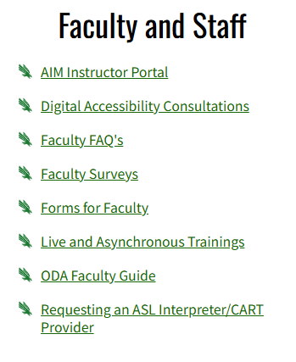
Resources on ODA Website for Faculty/Staff
Notes:
Febe

Slide 38
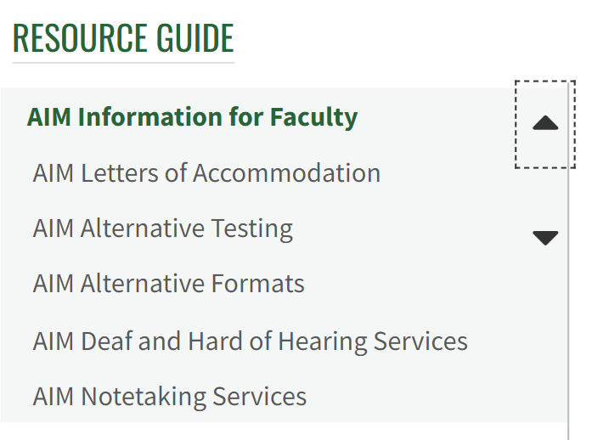
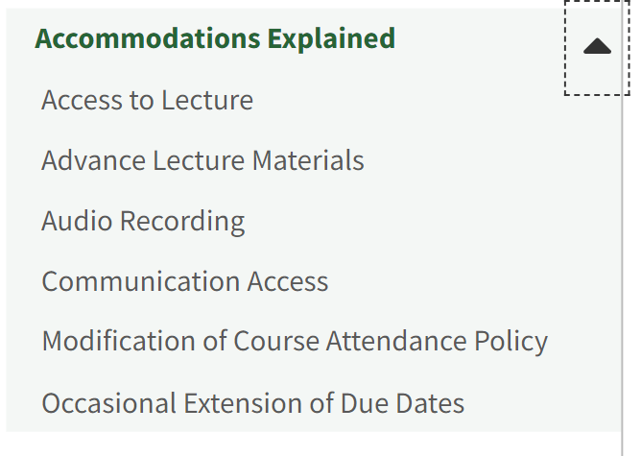
Resource Guide/Accommodations Explained
Notes:
Febe

Slide 39
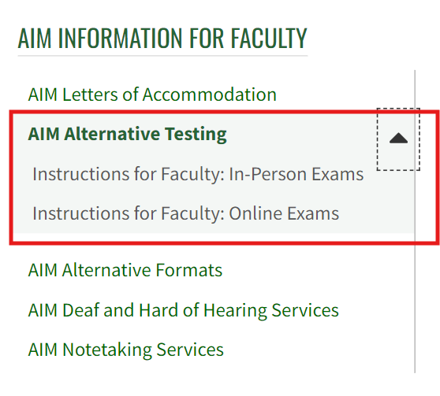
Navigating Alternative Testing in AIM
Notes:
Febe

Slide 40
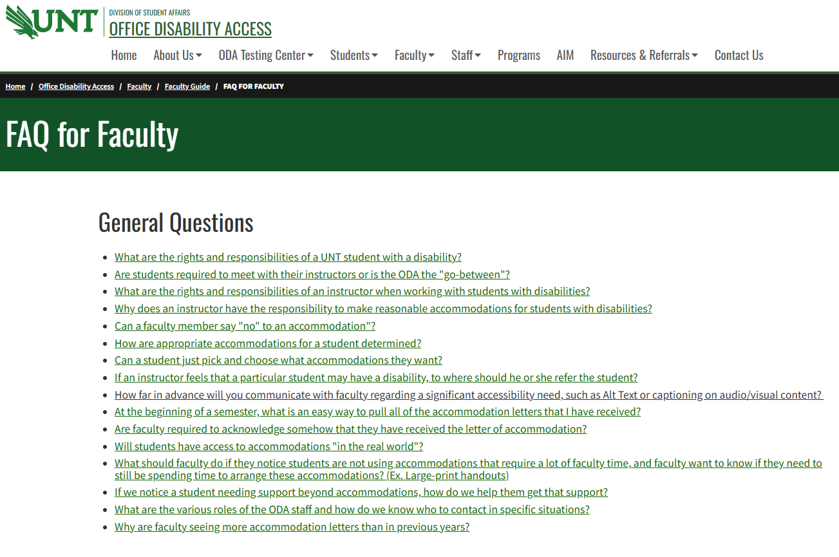
FAQ for Faculty
Notes:
Febe

Slide 41
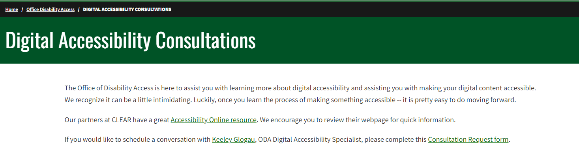
Digital Accessibility Consultations
Notes:
Febe

Slide 42
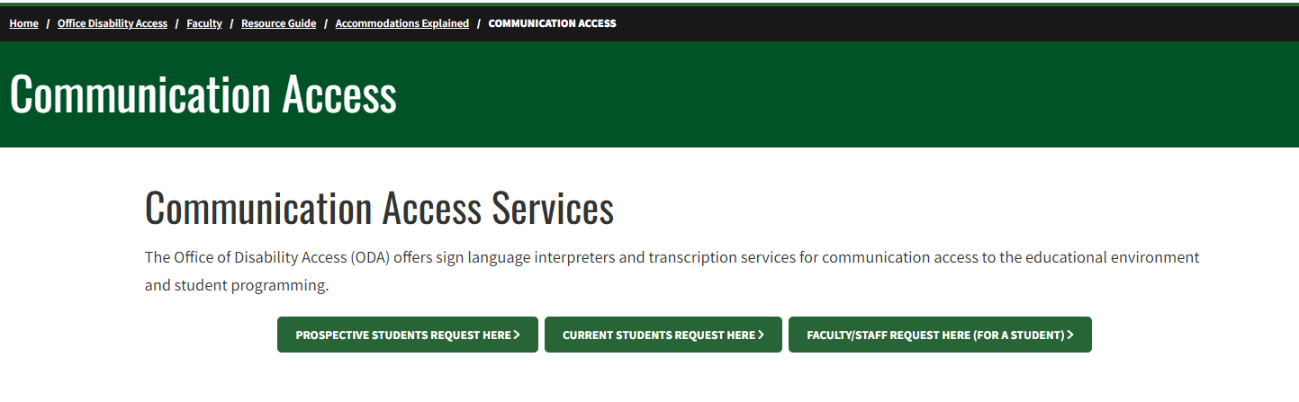
Requesting Communication Access Services
Notes:
Febe

Slide 43
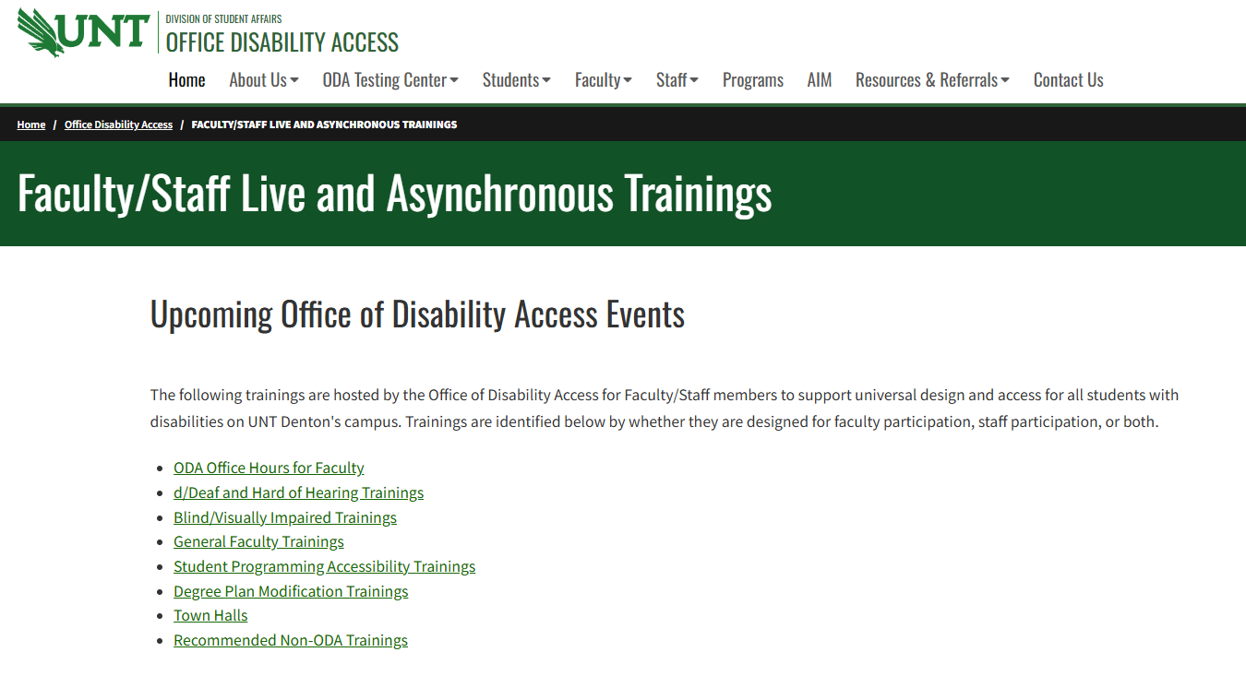
Faculty/Staff Live and Asynchronous Trainings
Notes:
Febe

Slide 44
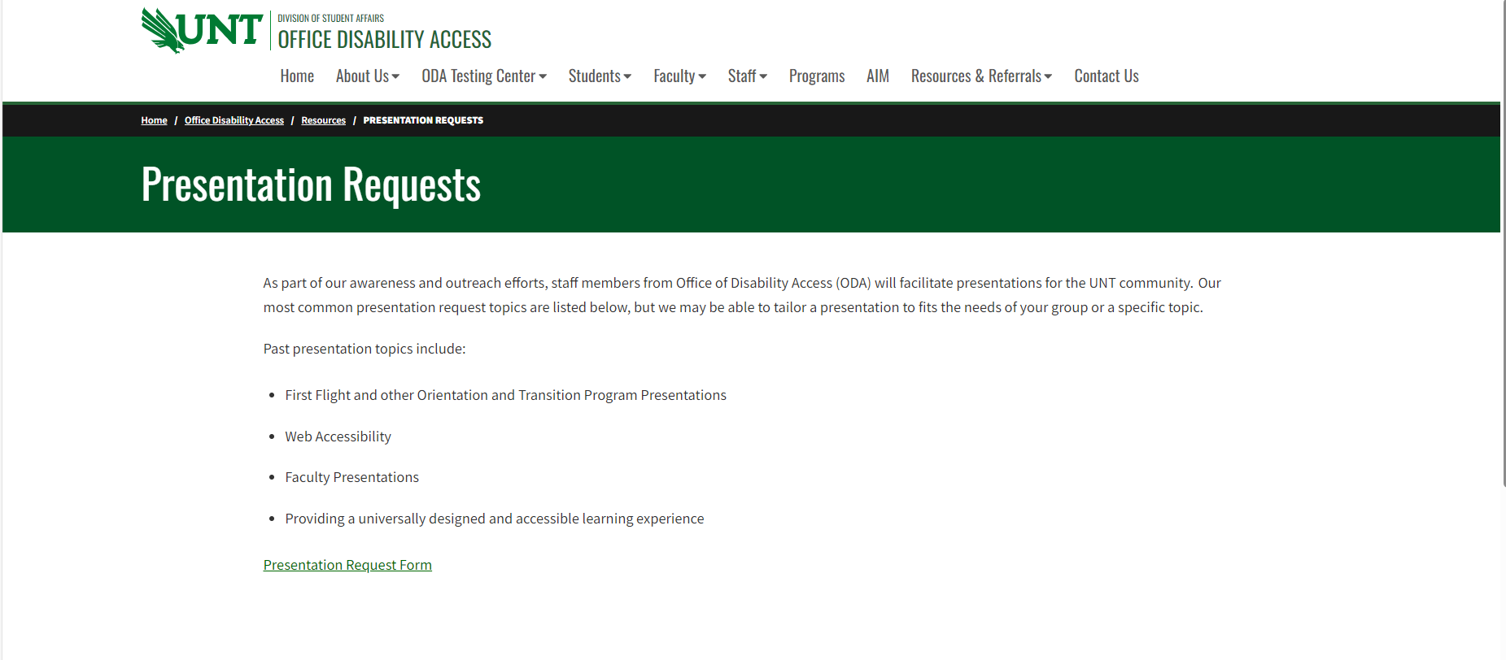
Presentation Requests
Notes:
Febe

Slide 45
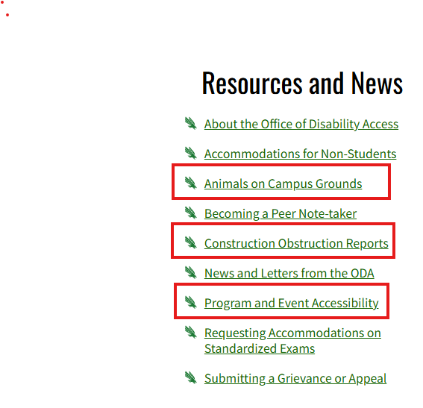
ODA Resources and News
Notes:
Febe

Slide 46
Recognition of Partnership
Notes:
Devin

Slide 47


Power of Partnership
We truly are here to PARTNER with faculty and staff in working with students
Invite opportunities to learn more about what’s working and what’s not – open invitation for conversation
Notes:
Devin

Slide 48
Campus Partners – A for Accessibility!
We have many ongoing campus partners, whom we so appreciate – such as Housing, Dining, Dean of Students, and Orientation and Transition Programs.
This year, we’ve strengthened existing partnerships with amazing people such as:
One-Stop – Taylor Moore
Facilities – Peter Palacios, Vince Stippec, Roberto Rubio
Parking – Nikki Sparks
Student Veteran Services – Byron Bailey
Clinical Preparation (Teacher Education) – Dr. Amanda Vickery and Ahveance Jones
Notes:
Devin

Slide 49
Accommodations
Notes:
Jessica

Slide 50
Reminder about Accommodations
Not a cookie-cutter list of accommodations
Charged to review accommodations on an individualized basis based on student barriers and therefore sometimes we may need to create a new accommodation
If there are any questions or concerns about implementation of an accommodation, we ask that direct these questions to the student’s ODA Coordinator, and not necessarily the student.
We never want the student to feel any kind of tension or negativity for using their accommodations.
We also do not want students to be in a position of negotiating their accommodations as that is a clear legal concern.
Notes:
Jessica

Slide 51
Accommodation Clarification
Accommodation descriptions on a student’s letter of accommodation provide essential information for implementation of the accommodation.
However, there may be times when faculty would like additional information. We always encourage faculty to contact our office.
The Faculty Guide on our website also has a wealth of information and we continue to build on it based on events such as this Town Hall and frequently asked questions.
The Office of Disability Access is very connected to universities and colleges locally, state-wide, and across the nation. We also are extremely connected to our national association, AHEAD. The accommodations that we are approving are not unique to UNT.
Notes:
Jessica

Slide 52
Student Access Outside the Classroom
Continued more programming and outreach regarding student access outside the classroom
We know that student engagement is a significant part of student success.
Campus community is charged with ensuring that all of the wonderful engagement options are accessible for all.
Common accommodations ODA supports for student programming:
Communication Access – ASL interpreters/CART providers
Alternative Formats for Students with Print Disabilities – depending on timeline of request (priority is academic materials)
Consultation on how to provide accommodations and make programs accessible
Notes:
Randi

Slide 53
Accessible Workplace
ODA is always willing to provide consultations to departments on how to make their department a more accessible place to work for people with disabilities.
However, we do NOT handle any accommodations for staff, including student staff.
Individuals interested in obtaining workplace accommodations should contact Keeshala Henderson, Workplace Accommodations Administrator for UNT System
Americans with Disabilities Act (ADA) (untsystem.edu)
Notes:
Randi

Slide 54
Programs
Here are a few programs ODA hosts:
Understanding Course Substitutions for Disability at UNT
Weekly Faculty Drop-In Trainings (Summer 2025 and beginning of Fall 2025)
Faculty Training for working with Blind/Visually Impaired Students
Faculty Training for working with d/Deaf and Hard of Hearing Students
Transitioning to a Post-Secondary Institution with Accommodations
Enhancing Accessibility at Student Programs and Events
Academic Advising Considerations for Students with Disabilities
Digital Accessibility Trainings
Student and Parent Orientation Sessions
Department/College Presentations
Faculty Senate Presentations
…and more!
The Fall 2025 calendar will be published on ODA’s website, UNT Calendar, and Bridge by September 1st.
Notes:
Randi

Slide 55
Thank you and Survey
Thank you so much for joining us!
We will email out a copy of the presentation materials as well as a brief survey.
Notes:
Randi

Slide 56
Contact Information
Email: disability@unt.edu
Phone: 940-565-4323
Notes:
Randi

